Slide 1
Increasing i-Train/ETPL Referrals to Your School Debbie Torres – CTE Advisor LAUSD John Alvarez – WIOA Navigator LAUSD

Slide 2
Why should your school be listed on i-train?
WorkSource and other agencies can use your school as a training facility for their participants who are being funded with WIOA training dollars
Adds students (outcomes) to your programs
Leftover money from training agreements can benefit the school
Helps meet AEBG requirements of utilizing other funding sources to support our schools

Slide 3
WHO ARE THE
AGENCIES?

Slide 4
WorkSource – 17 City of LA contracted locations that are WIOA funded
Job search assistance
Job readiness workshops
Supportive services
TRAINING!!!

Slide 5
AJCC – America’s Job Center of California (within LA County)
Job search assistance
Job readiness workshops
Supportive services
TRAINING!!!

Slide 6
EDD – Employment Development Department
Unemployment Insurance
State disability claims
Job search assistance
Job readiness workshops
TRAINING!!!...but only via TAA

Slide 7
Customer categories
WIOA Adult – 18 and over
WIOA Dislocated – 18 and over, probably collecting unemployment, lost a job in a shrinking industry, low or no chance of returning to work with that employer
TAA (Trade Adjustment Assistance) – lost job that was moved overseas, automatically a dislocated worker
DPSS Short-Term Vocational Training (STV) – participants are referred from DPSS to WorkSource/AJCC, WorkSource/AJCC makes the training arrangements

Slide 8
How does a person qualify for training through WorkSource?
Participant must enroll in the WorkSource WIOA program
Pass assessment administered by staff
If WorkSource has funding, they may provide a fully funded training contract
Participant must satisfy school admission requirements

Slide 9
Training Time Limits
WorkSource program year
July 1 – June 30
TAA referrals from EDD are usually more flexible with training duration

Slide 10
NVOC I-TRAIN Program
Fiscal Year | # of Students | Contract Amounts
2014-2015 | 0 | 0
2015-2016 | 9 | $18,074.80
2016-2017 | 46 | $68,281.14
NVOC TAA Program
Fiscal Year | # of Students | Contract Amounts
2014-2015 | 1 | $3,002.00
2015-2016 | 0 | $2,252.00
2016-2017 | 13 | $49,270.00

Slide 11
North Valley OC Totals
Year | # of Students | Contract Amounts | *Medical Assistant
2014-2015 | 1 | $3,002.00
2015-2016 | 9 | $20,326.80
2016-2017 | 59 | $117,551.14 | $39,769.00

Slide 12
How do I make my school more appealing to agencies and participants?
Find out what industry sector(s) the agency focuses on (probably health!)
Highlight the other CTE programs that are the shortest, especially those that can be completed in one semester
Be ready to provide specific employers who hire your students and what wages they are paying
Structure the training for 20 hours per week
Offer CTE programs/pathways that accommodate students who are limited English, VESL/VABE support

Slide 13
How do I get referrals?
THE AGENCY NEEDS TO KNOW WHO YOU ARE!
Visit your local agencies! Be ready with flyers, class schedules, business cards, a presentation, SWAG, data
Get to know the staff, especially the case managers
Campus tour!

Slide 15
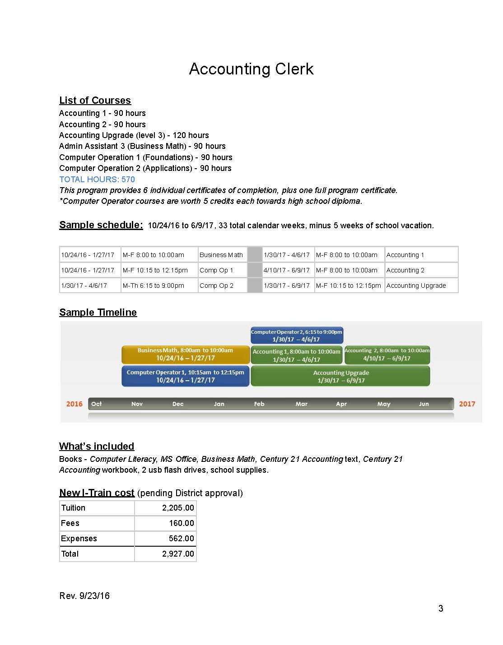

Slide 17
5 Star Customer Service

Slide 18
PROVIDING 5-Star Customer Service
Take care of the participant
Maintain communication with case managers
Follow the reporting schedules
Stay organized

