Slide 1
AB 86: Adult Education Los Angeles Regional Adult Education Consortium Strategies to Address the Gaps Donna Brashear, LAUSD – Marvin Martinez, LACCD http://ab86.cccco.edu

Slide 2
Los Angeles Regional Adult Education Consortium
Recent history – the
last five years
LARAEC Vision & Governance
Members
Stakeholders

Slide 3
Program Areas and Objectives
Elementary and Secondary Basic Skills
Classes for Immigrants
Programs for Adults with Disabilities
Short Term CTE Programs
Programs for Apprentices
Evaluation of existing AE programs
Evaluation of AE needs
Plans to integrate programs
Plans to address the gaps
Plans to accelerate a student’s progress
Plans to collaborate on provision of professional development
Plans to leverage existing regional structures

Slide 4
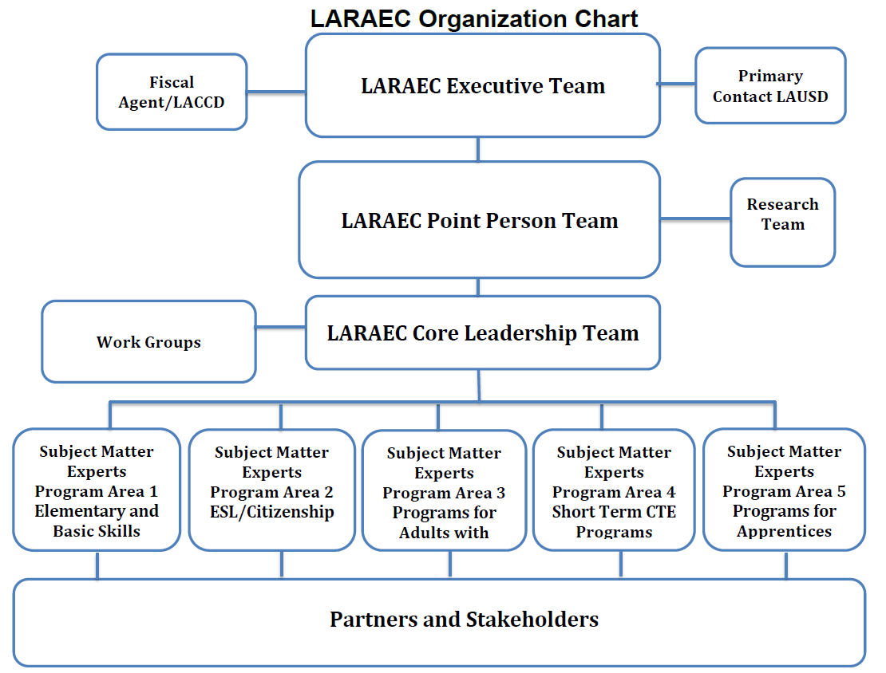

Slide 5
Los Angeles Regional Adult Education Consortium
Committees
Partners
Communications
Policy
Plan Writing

Slide 6
Process
Unique characteristics of members
Data Collection
From members
From partners
From teachers & students
From stakeholders
Evaluation of the data

Slide 7
Process
Included suggested strategies to address gaps.
Began to see needs/gaps themes.

Slide 8
Needs/Gaps
All program areas showed significant decreases in student served.
Short Term CTE - down 74%
ESL/Classes for Immigrants – down 65%
Programs for Apprentices – down 58%
1.5M in region do not have a HS Diploma
Economic Impact

Slide 9
Categorizing Needs/Gaps Program Area 2
Need/Gap | Solution
Counseling services/inadequate student future planning | Tighter connection to student services Provide student workshops: financial aid, career planning, goal setting, etc. Conduct field trips to universities, job sites, etc. Ensure counselors become focused on “next steps” Improve needs, placement and promotional assessment
Communication between staff, counselors, and teachers on student progress | Communication between staff, counselors, and teachers on student progress
Blended Instruction (dual enrollment) or clear career pathways for ESL students to follow | Create Career Pathways that accommodate ESL and basic skills students

Slide 10
Categorizing Needs/Gaps Program Area 4
Need/Gap | Solution
Counseling services | Provide student workshops: financial aid, career planning, goal setting, etc. Conduct fieldtrips to universities, job sites Ensure students know about career pathways Incept ESL counselors for ESL, VESL students Make counseling easily accessible (dedicated location and hours) Incept counselor tours and advisory periods Incept paid counselor/teacher (from all departments) forums
Long waiting lists/not enough program offerings | More CTE programs and classes
Clear student guidance during and between programs | More teacher advisors/guidance counselors to work with students

Slide 11
Gap Categories
Geographical and Access Gaps
Counseling and Student Support
Standardized Assessments and Cut-off Scores
Pathways to Employment and Career Advancement
Student and Course Articulation across Program & Districts
Leveraging Partnerships
Data Accountability System

Slide 12
Next Steps
Further development of Objective #4 strategies including “rolling it up” with Objectives 3, 5, 6 and 7
The gaps on which the regional plan will focus
Strategies to address the gaps
Resources needed
How to increase capacity
How to measure progress

Slide 13
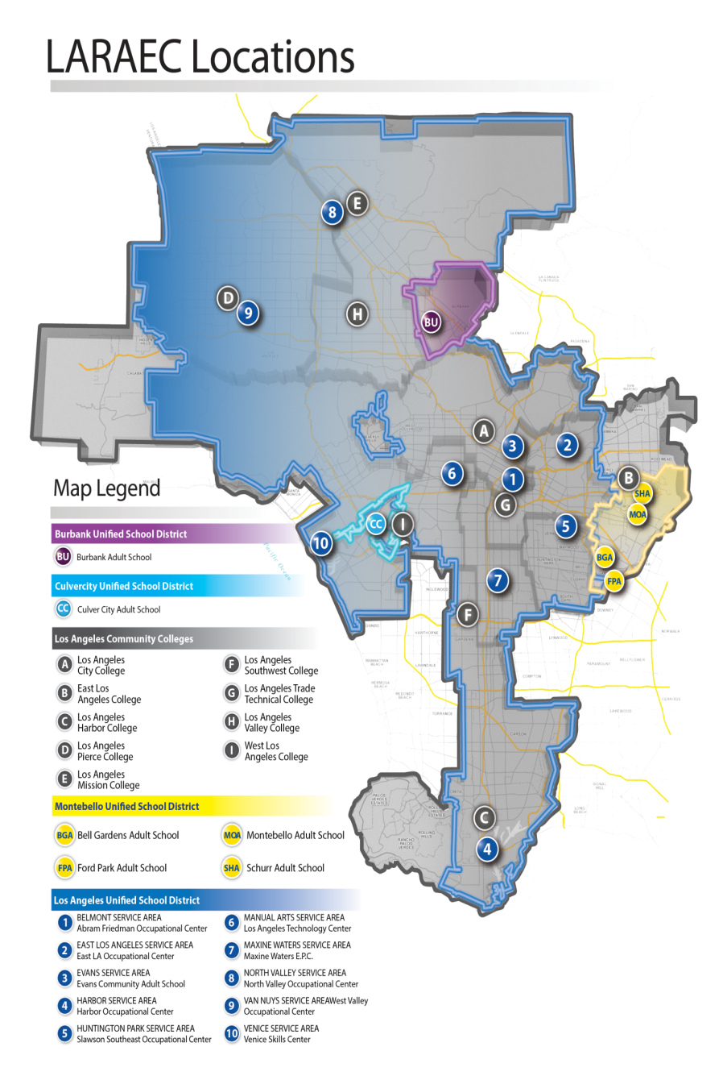
Lessons Learned
Final Comments
Questions?

